Slide 1
Convolutional Neural Networks (CNNs)
ICDSS - Kacper Kazaniecki (kk518)

Slide 2
Overview
Where are CNNs used? i.e. why should you care?
How do CNNs work?
Overview of common architectures
Live Demo

Slide 3
Where are CNNs used?
Fundamental modern building block of most computer vision systems:
Classification
Object Detection
Image Segmentation
Pose Estimation
Image Captioning
Generative models
+ many many more applications.

Slide 4
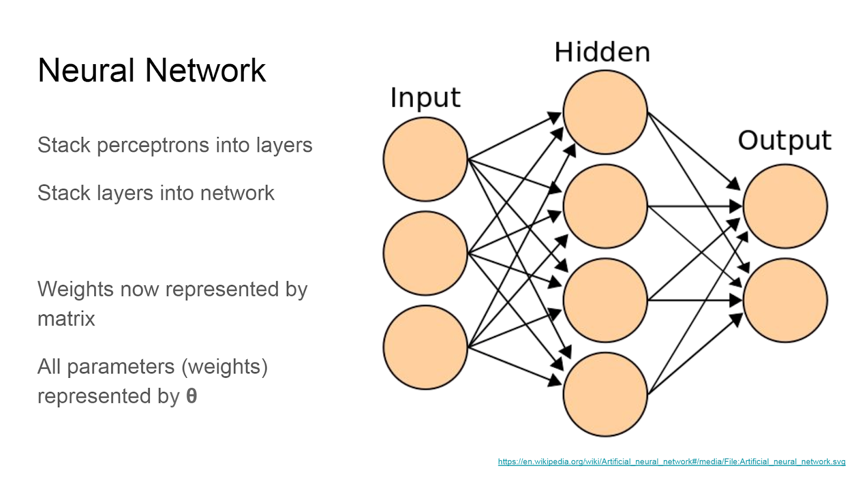
Fully connected neural network

Slide 5
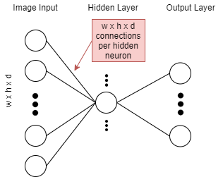
Issue when dealing with images
Take an image of size 200x200x3 (width x height x RGB colour depth)
That's 120,000 connections per neuron in 1 hidden layer!
We don't need that many connections and having so many would be very prone to overfitting.
Maybe there's an efficient way we can share weights?
-We’re often looking for the same feature in different parts of an image

Slide 6
Dealing with images
Input of image size 32x32x3 (width x height x depth)
Blue is our filter (our reusable weights)
Same as before, dot product between input and weights (+bias) making up the input to a neuron in the next layer
Note that the depth of filter and the input always matches.

Slide 7
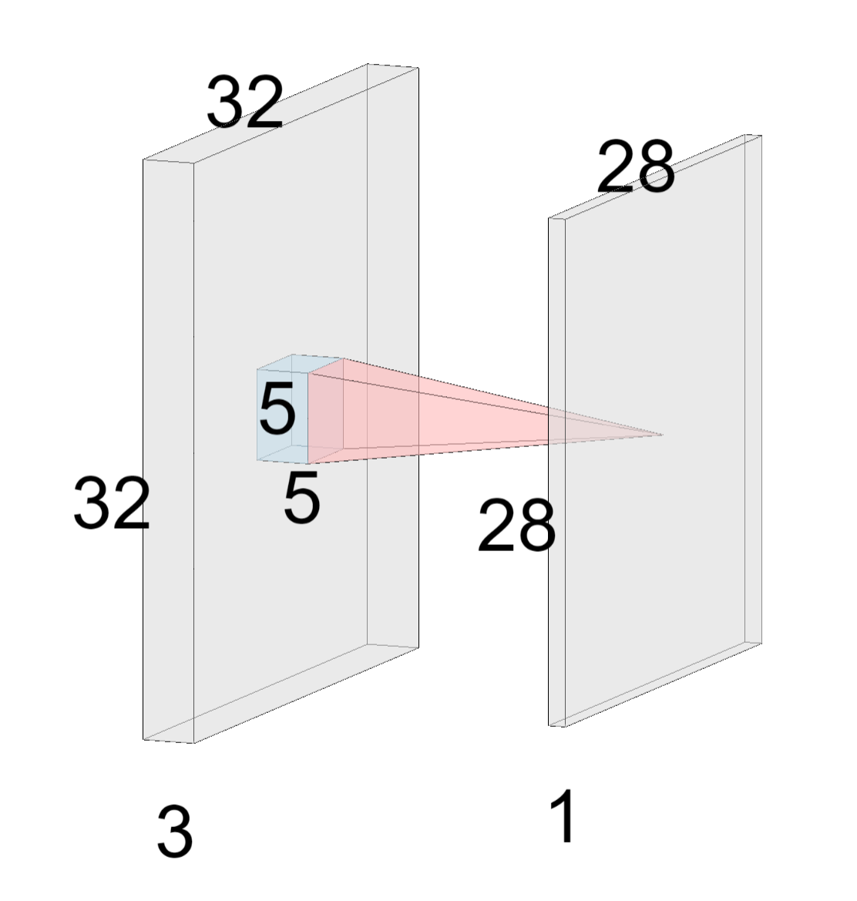
Convolution Layer
Input of image size 32x32x3 (width x height x depth)
Blue is our filter (our reusable weights)
Same as before, dot product between input and weights (+bias) making up the input to a neuron in the next layer
Note that the depth of filter and the input always matches.

Slide 8
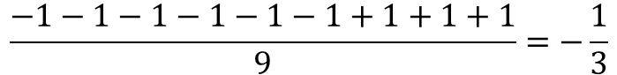
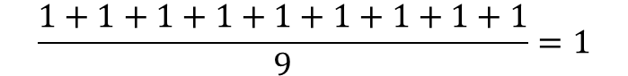
Filter (kernel)
1 | -1/3 | 1/3
1 | -1/3 | 1/3
7/9 | -1/9 | 1/3
1
-1/3
$$\frac{1+1+1+1+1+1+1+1+1}{9}=1$$
$$\frac{−1−1−1−1−1−1+1+1+1}{9}=−\frac{1}{3}$$
We’re using a stride of 1 here.

Slide 9
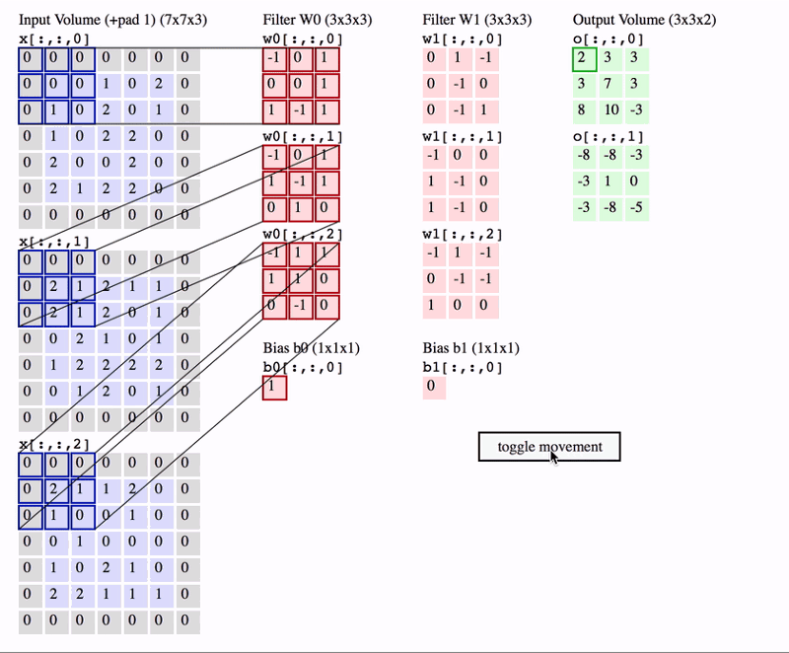
Extending to multiple filters with depth
Filter dimensions are equal for width and height (i.e. square filters)
Depth of filter matches depth of input
Source: http://cs231n.github.io/convolutional-networks/

Slide 10
Convolution Layer
Input of image size 32x32x3 (width x height x depth)
Blue is our filter (our reusable weights)
Same as before, dot product between input and weights (+bias) making up the input to a neuron in the next layer
Note that the depth of filter and the input always matches.

Slide 11
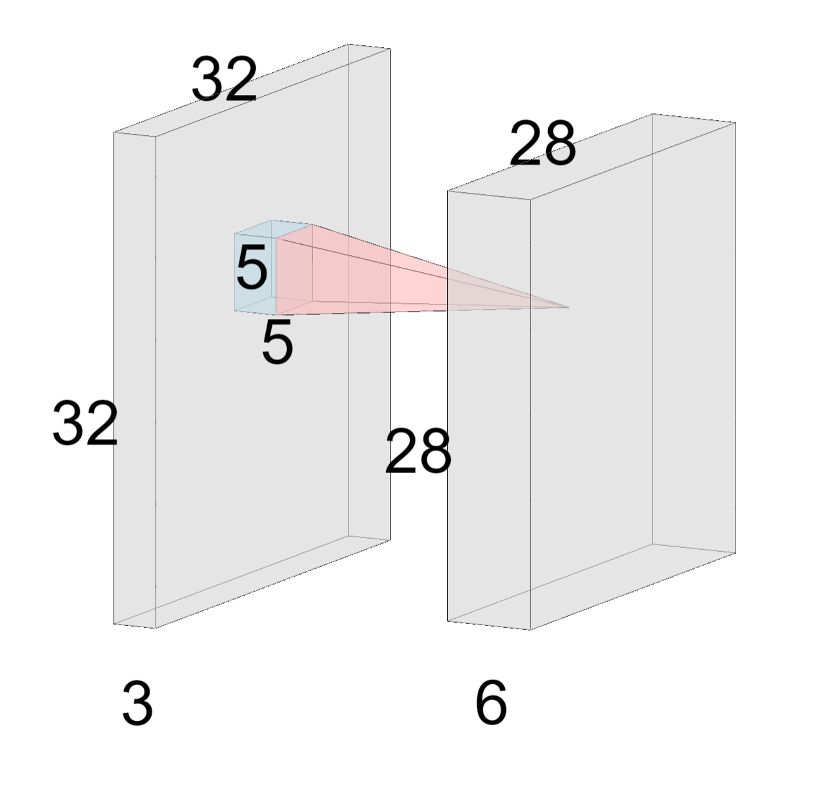
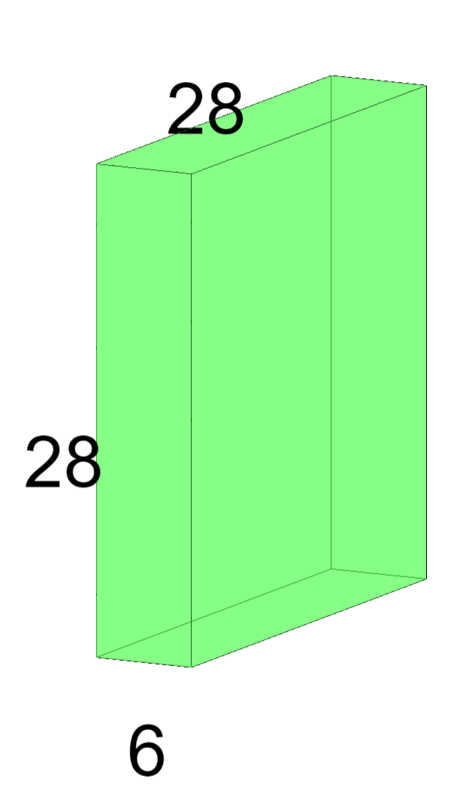
Multiple filters
Given 6 filters of 5x5*, we get 6 corresponding activation maps
We’d usually apply an activation function on the activation maps (elementwise). E.g. ReLU
Activation Function
* x3 depth implied

Slide 12
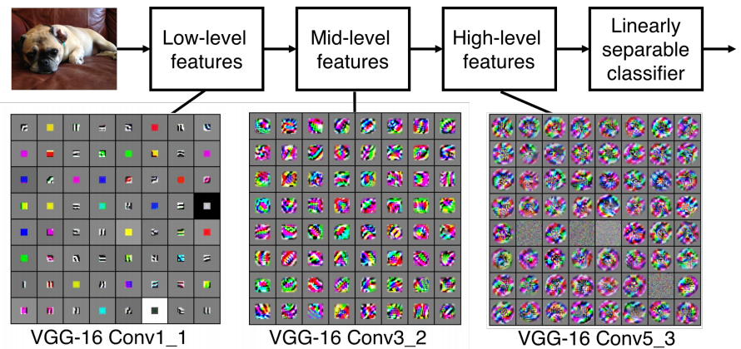
Visualisation
Visualization of VGG-16 by Lane McIntosh. VGG-16 architecture from [Simonyan and Zisserman 2014].

Slide 13

Dimensions
N
F
1 | -1/3 | 1/3
1 | -1/3 | 1/3
7/9 | -1/9 | 1/3
$$Output= \frac{N −F}{stride}+1$$
Examples: For N = 5, F = 3
Stride 1: (5 - 3)/1 + 1 = 3
Stride 1: (5 - 3)/2 + 1 = 2
Stride 1: (5 - 3)/3 + 1 = 1.6666 < ---- doesn’t fit

Slide 14
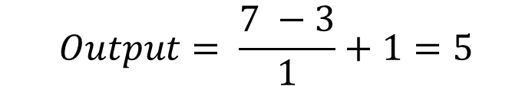

Padding
Usually to preserve dimensions
0 | 0 | 0 | 0 | 0 | 0 | 0
0 | -1 | 1 | -1 | -1 | -1 | 0
0 | -1 | 1 | -1 | -1 | -1 | 0
0 | -1 | 1 | -1 | -1 | -1 | 0
0 | -1 | 1 | -1 | -1 | -1 | 0
0 | -1 | -1 | -1 | -1 | -1 | 0
0 | 0 | 0 | 0 | 0 | 0 | 0
$$Output= \frac{N −F}{stride}+1$$
Our previous example with stride 1 but we want to keep the dimensions
$$Output= \frac{7 −3}{1}+1=5$$

Slide 15
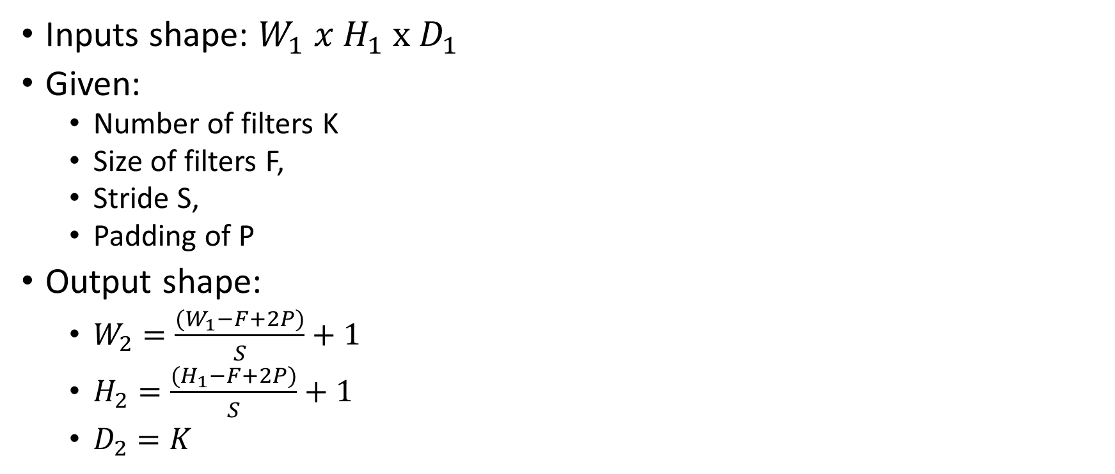
Dimensions of convolutional layer in general
0 | 0 | 0 | 0 | 0 | 0 | 0
0 | -1 | 1 | -1 | -1 | -1 | 0
0 | -1 | 1 | -1 | -1 | -1 | 0
0 | -1 | 1 | -1 | -1 | -1 | 0
0 | -1 | 1 | -1 | -1 | -1 | 0
0 | -1 | -1 | -1 | -1 | -1 | 0
0 | 0 | 0 | 0 | 0 | 0 | 0
Inputs shape: $W_{1} x H_{1} x D_{1}$
Given:
Number of filters K
Size of filters F,
Stride S,
Padding of P
Output shape:
$W_{2}=\frac{(W_{1}−F+2P)}{S}+1$
$H_{2}=\frac{(H_{1}−F+2P)}{S}+1$
$D_{2}=K$

Slide 16

Max Pooling
Given a 3x3 max pooling filter with stride 2
$$Output= \frac{N −F}{stride}+1$$
1 | -1/3 | 1/3
1 | -1/3 | 1/3
7/9 | -1/9 | 1/3
1 | 1/3
1 | 1/3
Max Pooling

Slide 17
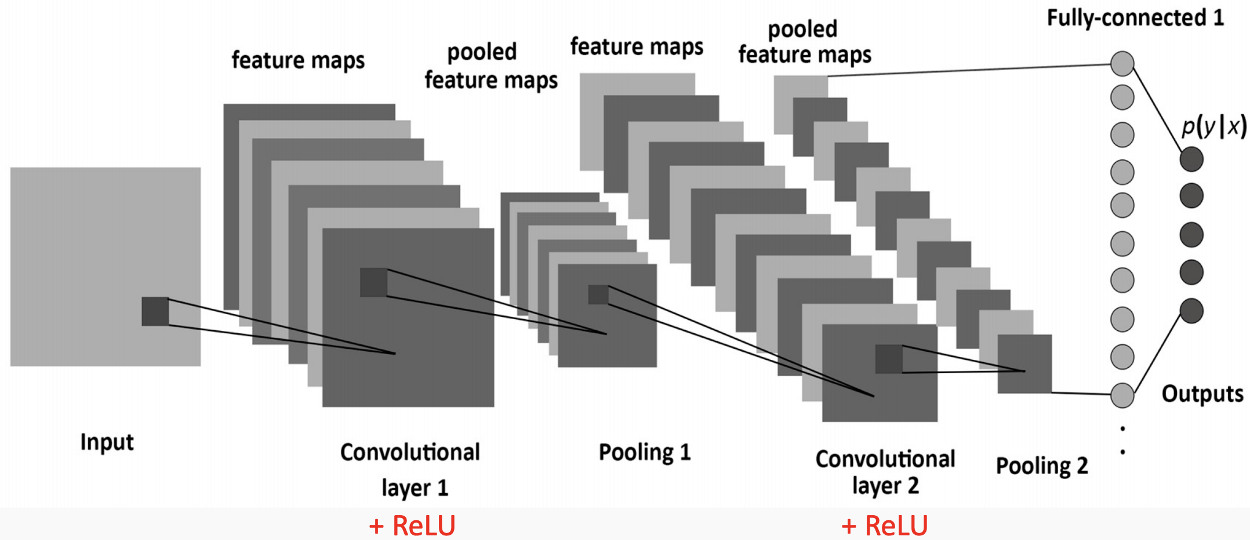
Example of a CNN

Slide 18
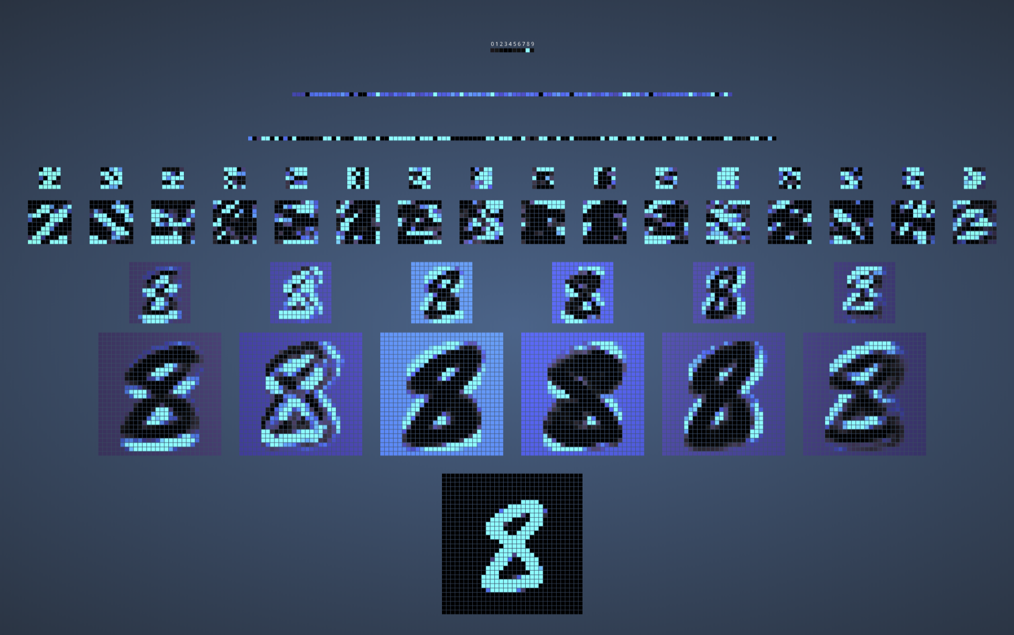
https://www.cs.ryerson.ca/~aharley/vis/conv/flat.html

Slide 19
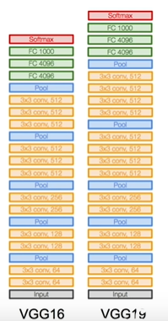
VGG
1st place @ ILSVRC-2014 localisation
2nd place @ ILSVRC-2014 classification
Image Source: http://cs231n.stanford.edu/

Slide 20
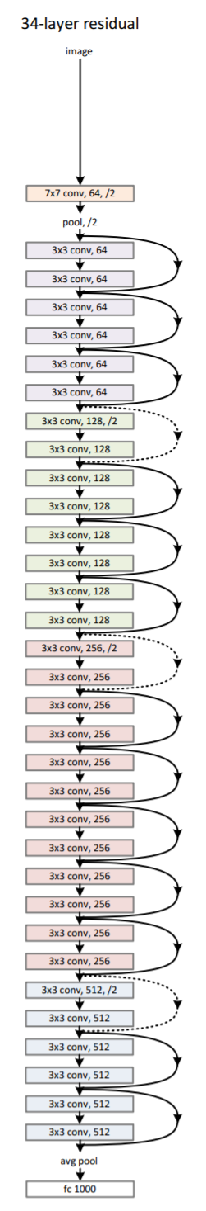
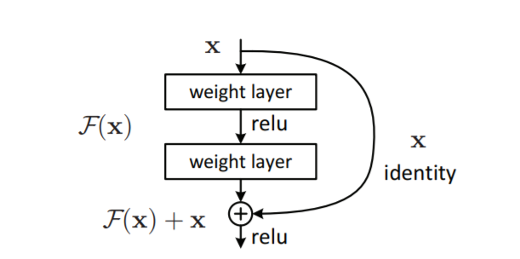
ResNet
1st place @ ILSVRC-2014 classification
Source: https://arxiv.org/abs/1512.03385

Slide 21
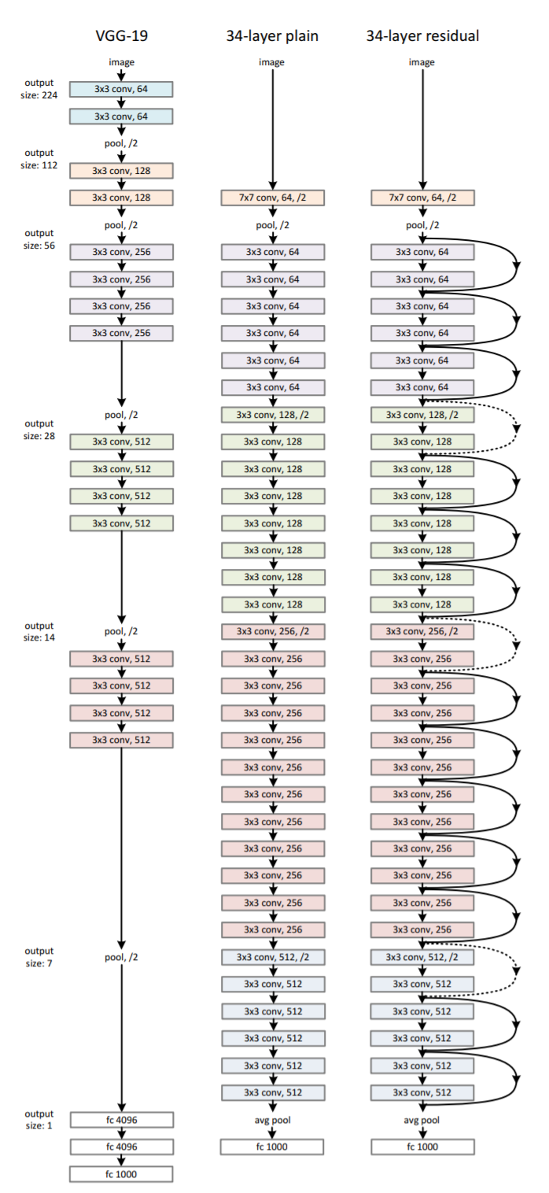
VGG vs ResNet
Source: https://arxiv.org/abs/1512.03385

